Slide 1
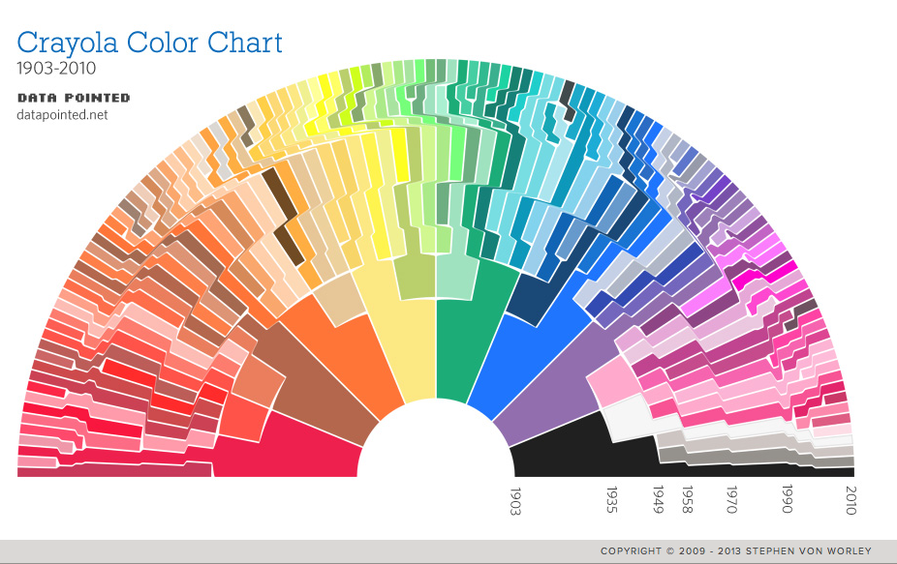

50 Shades of Data
Lucas Jellema – AMIS | Conclusion February 2021

Slide 2



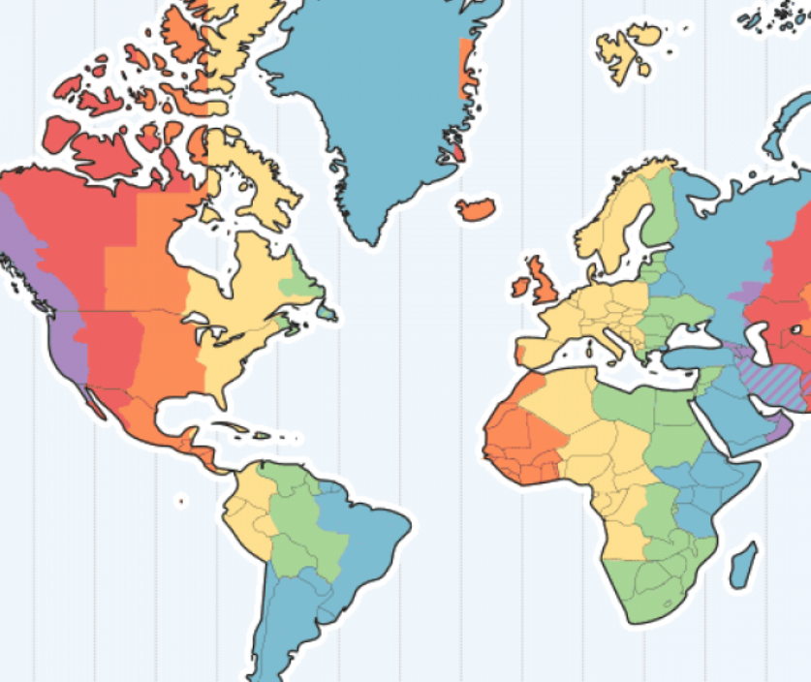






Lucas Jellema CTO for AMIS | Conclusion Cloud Solution Architect
8 hours
lucas.jellema@amis.nl | technology.amis.nl | @lucasjellema | lucas-jellema

Slide 3
Lucas Jellema CTO for AMIS | Conclusion Cloud Solution Architect
lucas.jellema@amis.nl | technology.amis.nl | @lucasjellema | lucas-jellema

Slide 4


Slide 6


Slide 7


Slide 8
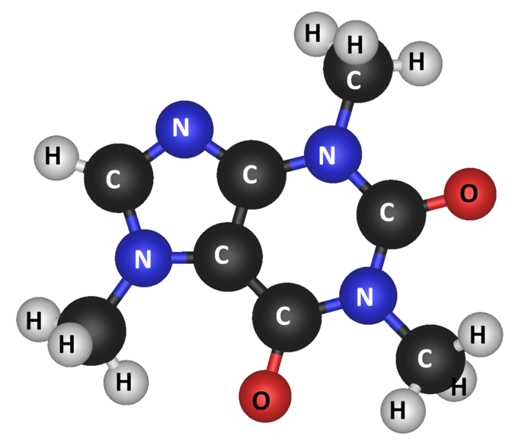
1
0
0
1
0
0
1
1
1
0
1
1
0
0
1
1
1
0
1
1
0
0
1
0
This Photo by Unknown Author is licensed under CC BY-SA
Notes:
mass of 0 and 1
at the core
every molecule is protons, electrons and neutron (or: subatomic particles) and forces
all data is 0 and 1 => unstructured (whilst unknown)

Slide 9











Slide 10
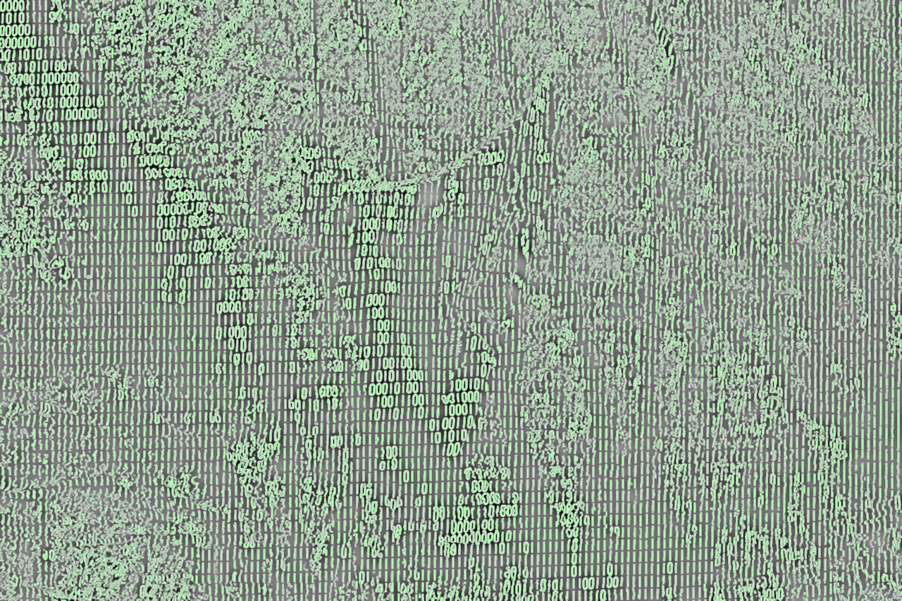




Slide 11

Encoding Filters
ASCII
UTF

Slide 12










Encoding Filters
ASCII
UTF
Characters
Letters
DNA Sequences
timestamp
geo location
Words (in a specific language)
Virus
Scientific Number
Yeast
CV
Bacterium
Recipe
Poem
Terms of Service

Slide 13

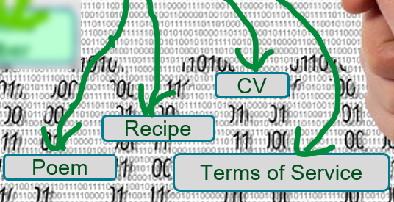








frequencies, loudness, noise, echo, …
Encoding Filters
MP3, FLAC, LINEAR16, MULAW, AMR, OGG_OPUS
Sound
pitch, gender, age, body position, language?
Animal Sound
Music
Dog
Human Speech
Cat
piece? composer, title, release date, artists, sales, lyrics
Words (in a specific language)
Cricket
Owl

Slide 14
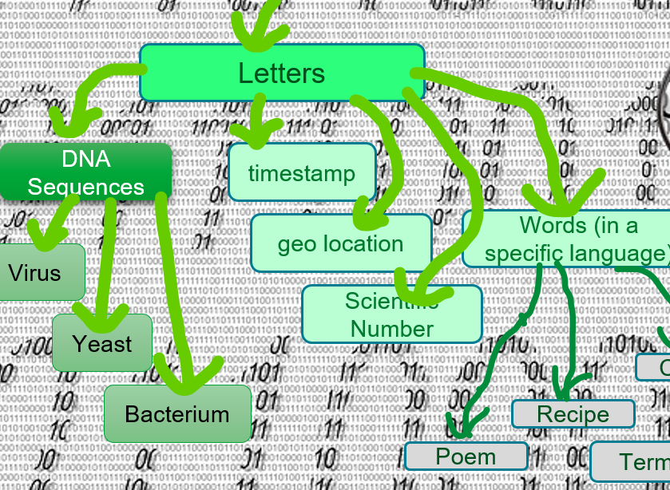





color, brightness, resolution, timestamp, location
Encoding Filters
BMP, JPEG, PNG, GIF
Image
how many, how large, what color
how many, size, hair color, glasses, footwear
People
Characters
Objects
JFK
apply OCR
CR7
MLK
Dog
AOC
Car
Ball
Tree

Slide 15
Animal Sound
People
Characters
Objects
Music
JFK
Dog
Human Speech
CR7
MLK
Dog
Cat
AOC
Car
Words (in a specific language)
Cricket
Ball
Owl
Tree
DNA Sequences
timestamp
geo location
Virus
Words (in a specific language)
Scientific Number
Yeast
CV
Bacterium
Recipe
Poem
Terms of Service

Slide 16
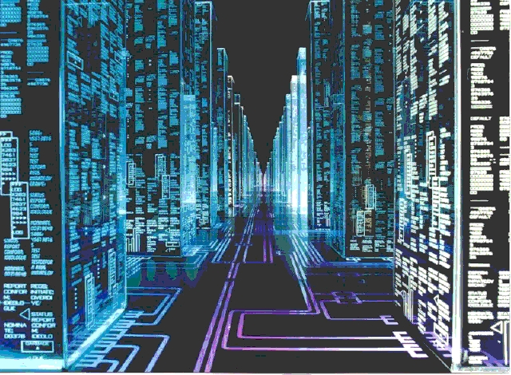
Structured means Well Described
If we know more about our data (meta data) we can be more effective and more efficient with that data
understand the meaning and context
validate, enrich, compress
easier, faster access and perform operations count, filter, read targeted properties

Slide 17

Is that relational data?
Or unstructured data better suited for a NoSQL database?

Slide 18


Multiple face[t]s of the Same Data
Data is not inherently relational or graph-style or document-oriented
It can be unstructured [and almost worthless] – if we know nothing about it at all
We categorize by usage of the data
The same data can be used in various ways
the nature of the data is in the eye of the beholder in other words: the consumer of data sees what they want to see in the data
shape, freshness, granularity, location, authorization, frequency, volume, availability

Slide 19
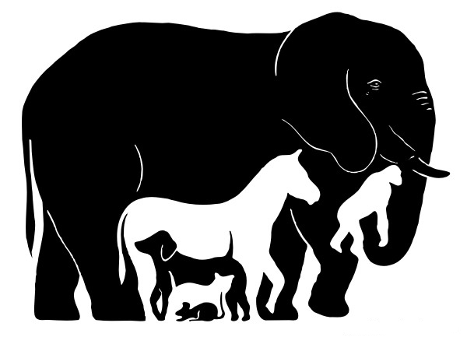
Same Data, Multiple Usages
A single truth, a single storage, multiple query engines
for example: Oracle converged Database
A single truth, multiple storage, multiple query engines

Slide 20


Tweet! #TD2021

Slide 21
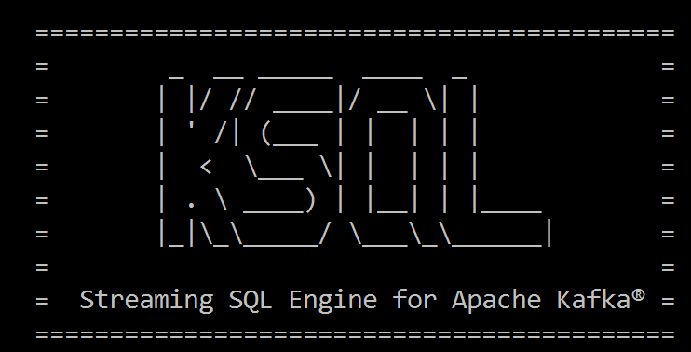
Select from <stream of tweet events>
select text , author , timestamp
from tweets
Where tag = 'TD2021'
<--- streaming data

Slide 22
Select Running Count from <stream of tweet events>
select tag
, count(*) tweet_count from tweets
group by tag
Every tweet with one or more hashtags will trigger new results:
the updated count for each of the tags in the tweet
Note: the results are a stream [too]

Slide 23

BOL - CQRS

Slide 24

Books Online - WebShop
Products
Webshop visits
searches
product details
Orders
Product updates
Read only
On line
Speed is crucial
XHTML & JSON
> 5M visits
Data manipulation
Data Quality (enforcement)
<10K transactions
Batch jobs next to online
Speed is nice
firewall

Slide 25


Nightly generation
DMZ
Webshop visits
searches
product details
Orders
Products
Products
Products
Products
Product updates
Read only
On line
Speed is crucial
XHTML & JSON
> 1M visits
Read only
JSON documents
Images
Text Search
Scale Horizontally
Stale but consistent
Data manipulation
Data Quality (enforcement)
<10K transactions
Batch jobs next to online
Speed is nice
firewall

Slide 26
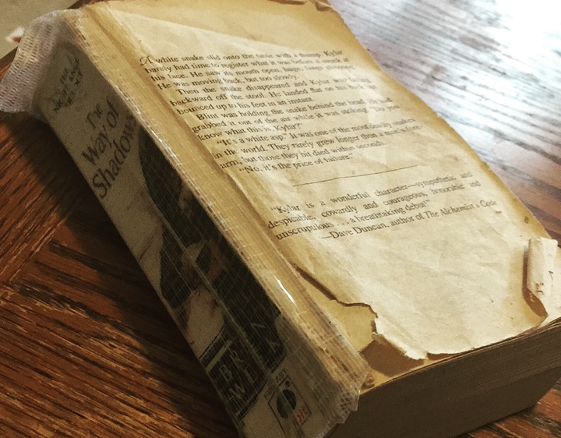
Information is read more often than it is written

Slide 27
Products
Data Manipulation
Data Retrieval

Slide 28
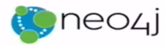



Products
Data Manipulation
Quick Product Search Index
Special Products
Data Retrieval
Toys
Product Clusters
Product Store in SaaS app
Food Stuff
Notes:
Data manipulation and retrieval in separate places
(physical data proliferation)
Query store is optimized for consumers
Level of detail, format, filters applied
For performance and scalability, independence, productivity lower license fees and lower TCO, security

Slide 29
Comand Query Responsbility Segregation = CQRS
Detect changes
Products
Extract Data
Data Manipulation
Transport Data
Convert Data
Special Products
Apply Data
Data Retrieval
Toys
Quick Product Search Index
Product Clusters
Food Stuff
Product Store in SaaS app
Notes:
No Event Sourcing
No events (?)
No green field
Packages Applications/SaaS
Databases (RDBMS, NoSQL) getting changes from applications directly
Challenges – at scale, with enough speed and consistently: do not let query store get into an exposed state that could not exist/be right!
Detect relevant changes
Extract relevant changes
Transport
Convert
Apply in correct order and reliably (no lost events)
Note: after detect and extract, an event can be published

Slide 30


From C to Q
How quickly?
How frequently?
How reliably?
How atomically?
Products
Quick Product Search Index

Slide 31
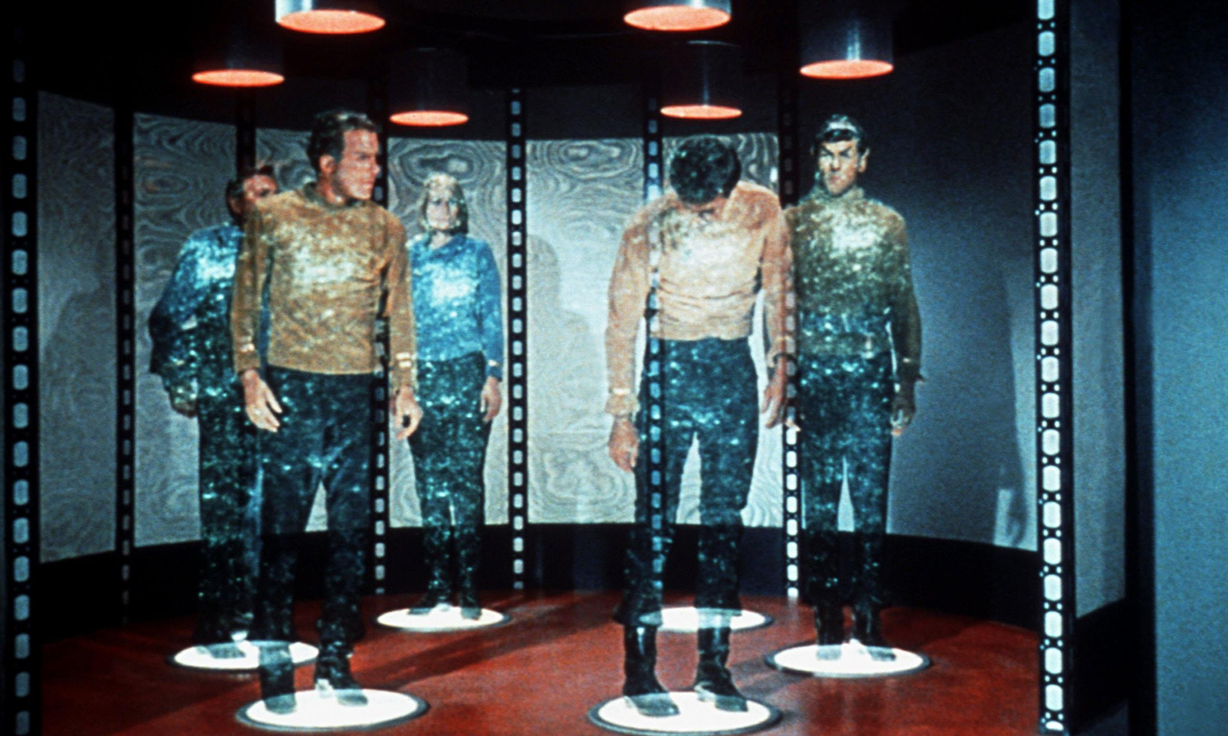

Slide 32
From C to Q
How quickly?
How frequently?
How reliably?
How atomically?
Data Authorization Considerations
Locations & Connectivity
Full resynch | restore of Query Store
Products
Quick Product Search Index

Slide 33


Data Consistency
1. All transactions instantly processed everywhere (all data in synch) 2. Every reader will only ever see a valid situation (sum of complete transactions) that has really existed at some moment in time

Slide 34
Real Time live | fresh | instantaneous | on line | synchronous

Slide 35


Slide 36


Slide 37


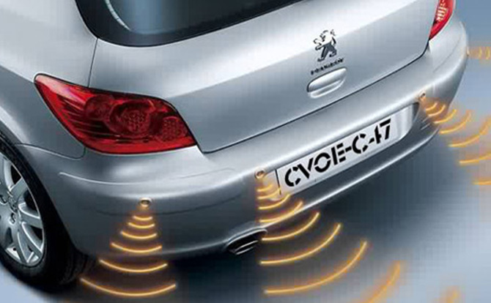


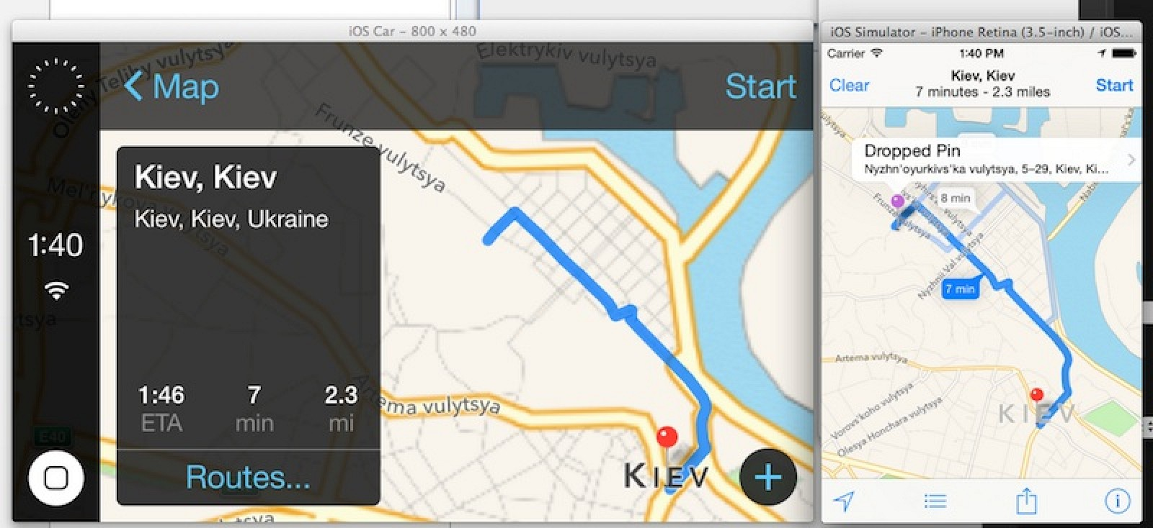
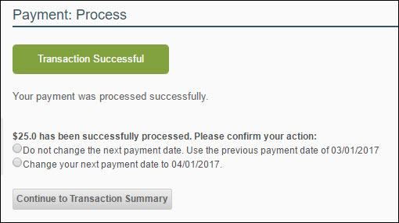


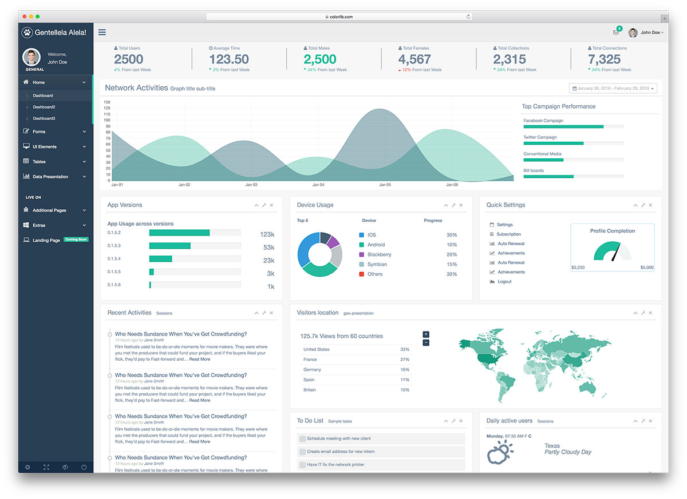

Slide 38


Slide 39

< 10 ms
< 100 ms
< 500 ms
<3 secs
> 3 secs
Machine Response
Human Reaction
39

Slide 40


< 10 ms
< 100 ms
< 500 ms
<3 secs
> 3 secs
Machine Response
Human Reaction
40

Slide 41
41

Slide 42
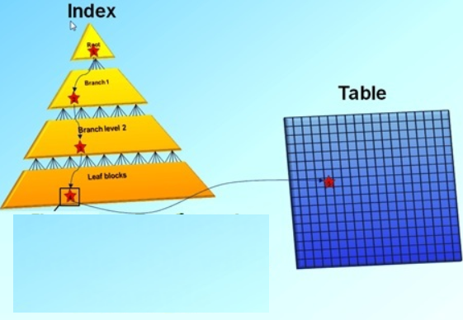
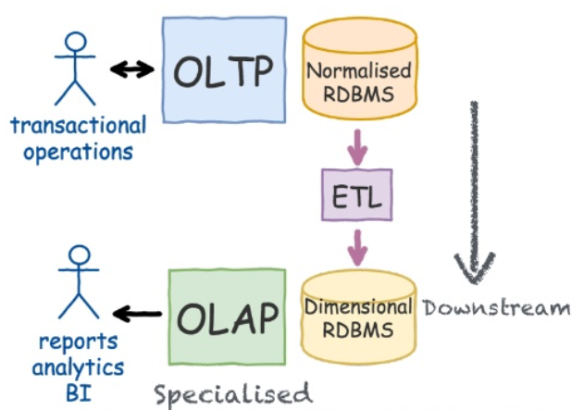
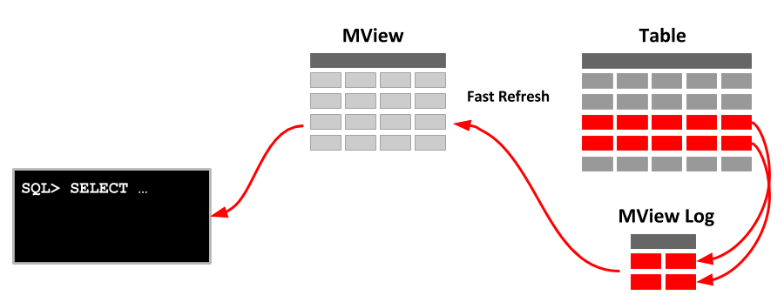
CQRS is not new
Notes:
https://www.slideshare.net/LorenzoNicora/from-c-to-q-one-event-at-the-time-event-sourcing-illustrated

Slide 43
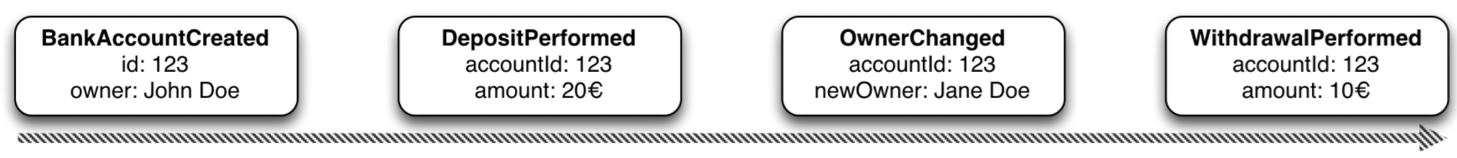
Event Sourcing Driving CQRS
amount: 10
Owner: Jane Doe
Events
Current State
Event Store
accountId: 123
Notes:
Events are immutable facts
Current state (active record) is derived from sum of events
Read optimized aggregates are created for specific use case – based on events and rebuildable at any time

Slide 44
Event Sourcing Driving CQRS
Events
Current State
Event Store
Other State Aggregate
Notes:
Events are immutable facts
Current state (active record) is derived from sum of events
Read optimized aggregates are created for specific use case – based on events and rebuildable at any time

Slide 45

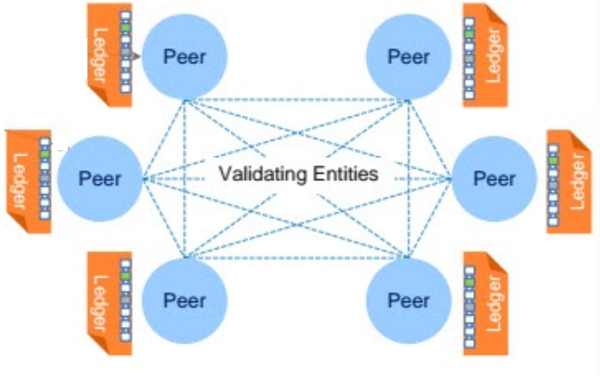





Distributed Database with Event Sourcing & Current State
Transaction
World State
Notes:
Blockchain!

Slide 46


Integrity
Madelon’s pasje
Real world vs World of Databases
Relax!
Anomaly detection
Rebellion

Slide 47

Data Constraints to protect integrity
Allowable values
Mandatory attributes
(Foreign Key) References
NULL
Constraints on
type
length
format
Spelling
Character encoding
Notes:
https://specify.io/concepts/microservices

Slide 48


Data is representation of the known real world
How useful is it to enforce data integrity?
Notes:
https://specify.io/concepts/microservices

Slide 49


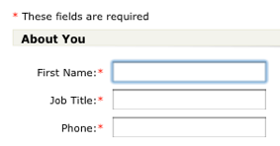

Data Integrity
Why?
Is it about truth?
About regulations and by-the-book?
Allow IT systems to run smoothly and not get confused?
About auditability and non-repudiation?
What about the real world?
Data in IT is just a representation; if the world is not by the book – what should IT do?
Lucas
Santa Claus
987654321
Notes:
https://specify.io/concepts/microservices

Slide 50
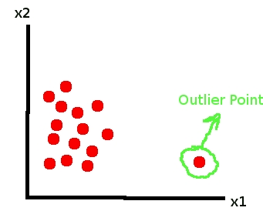
Anomaly Detection
Find fishy values and derive business integrity rules by scanning data
Act on data “out of bounds”

Slide 51

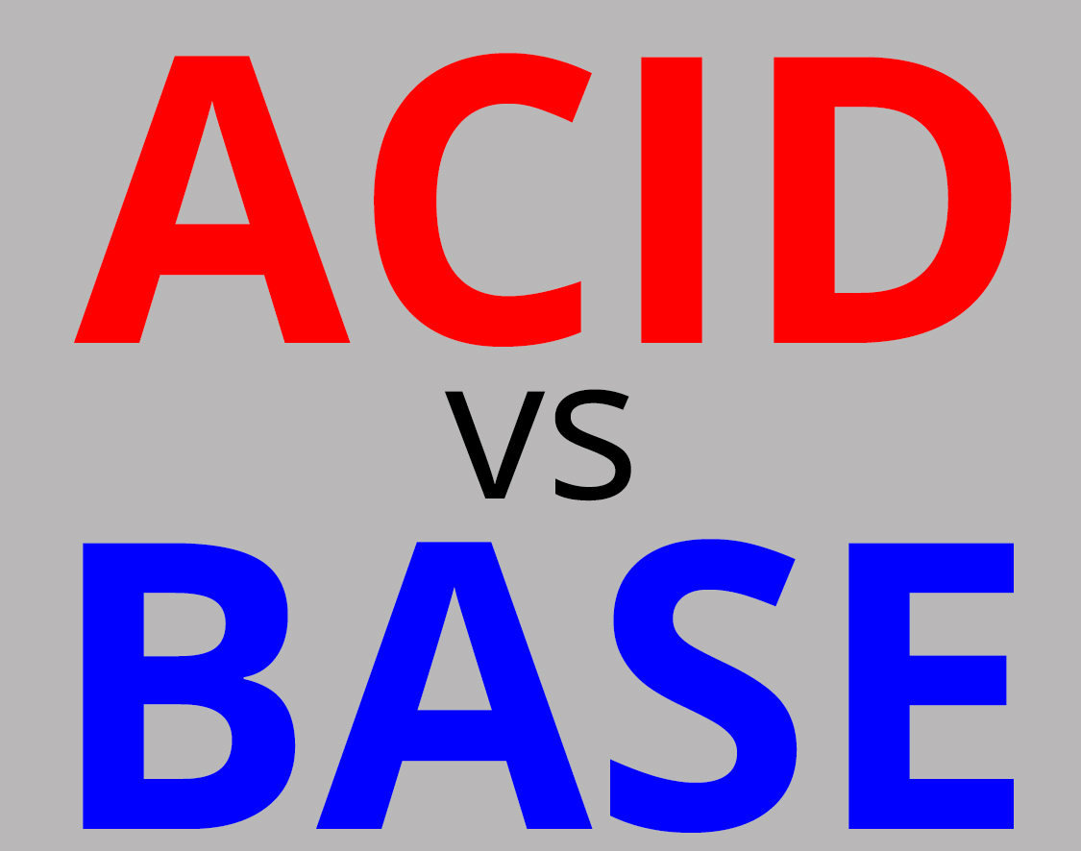



NoSQL
SQL
Notes:
WebScale
‘No ACID
BASE
Speed, reads
Redundancy
Read-optimized format
Not all use cases require ACID (or can afford it)
Read only (product catalog for web shops)
Inserts only and no (inter-record) constraints
Big Data collected and “dumped” in Data Lake (Hadoop) for subsequent processing
High performance demands
Not all data needs structured formats or structured querying and JOINs
Entire documents are stored and retrieved based on a single key
Sometimes – scalable availability and developer productivity is more important than Consistency – and ACID is sacrificed
CAP-theorem states: Consistency [across nodes], Availability and Partition tolerance can not all three be satisfied

Slide 52
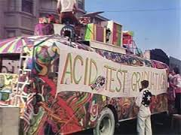
ACID comes at a cost – performance & scalability
Transaction results have to be persisted [before the transaction completes] in order to guarantee D
Concurrency requires some degree of locking (and multi-versioning) in order to have I
Constraint compliance (unique key, foreign key) means all data hangs together (as do all transactions) in order to have C
Two-phase commit (across multiple participants) introduces complexity, dependencies and delays, yet required for A
Notes:
https://specify.io/concepts/microservices

Slide 53
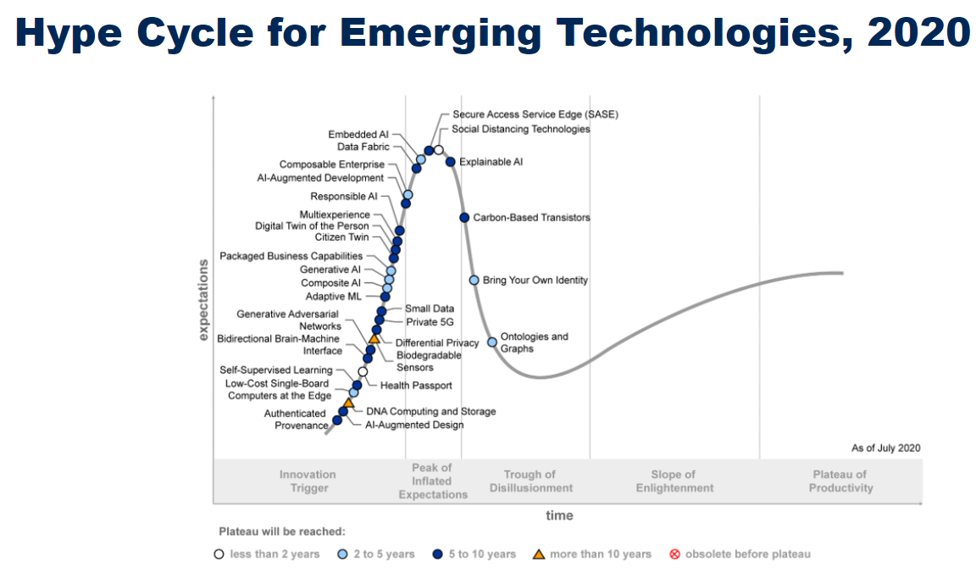

Slide 54
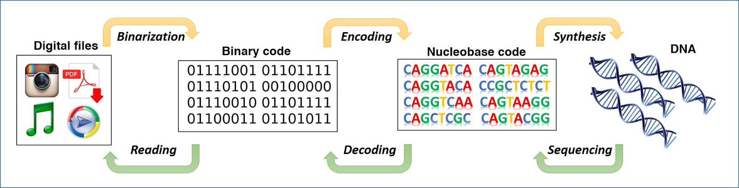

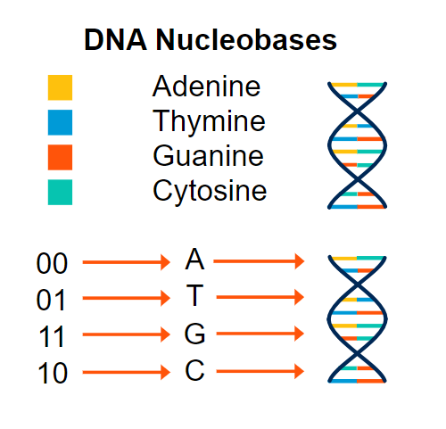
DNA Storage
Very compact
Quite enduring

Slide 55
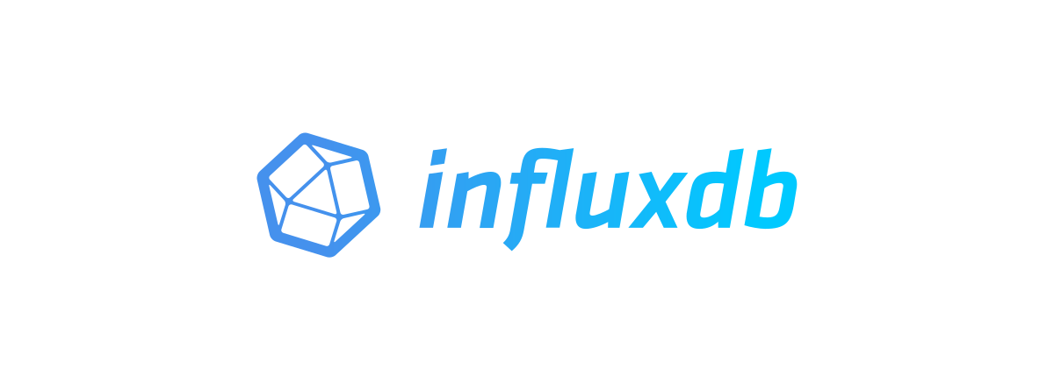

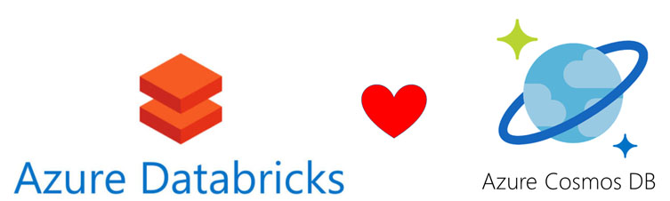




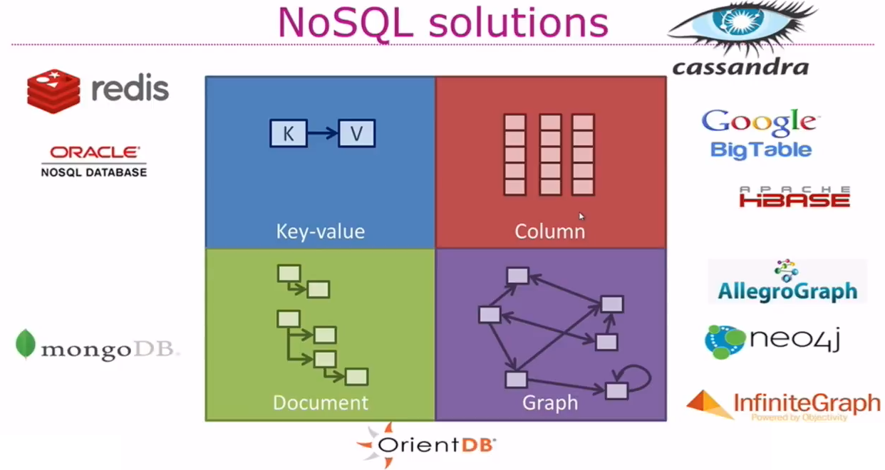


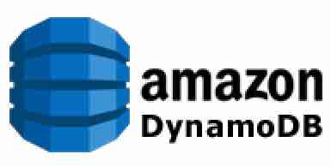












Types of NoSQL
Notes:
https://specify.io/concepts/microservices

Slide 56


Slide 57


Slide 58

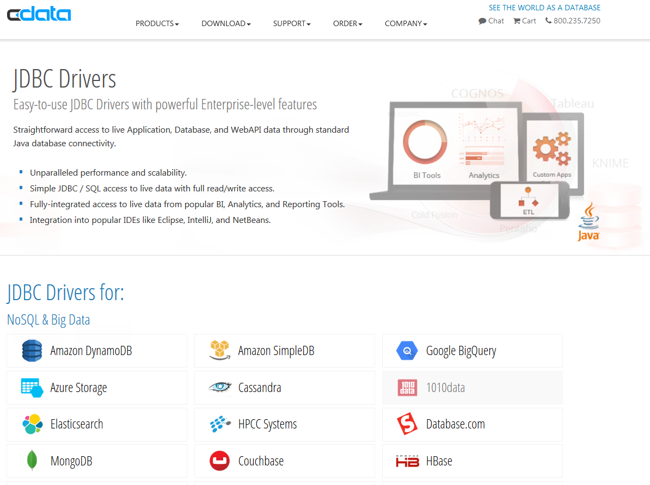


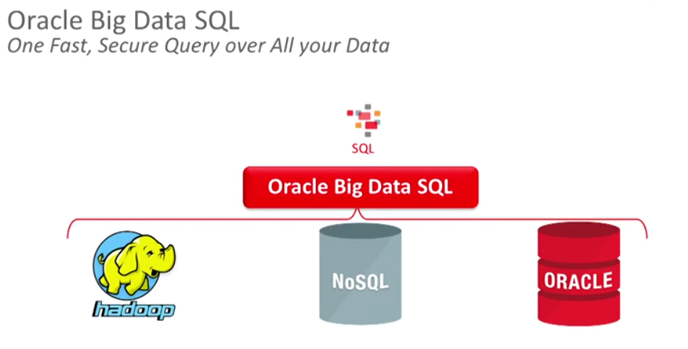
NoSQL n’est pas No SQL
Oracle Cloud SQL

Slide 59
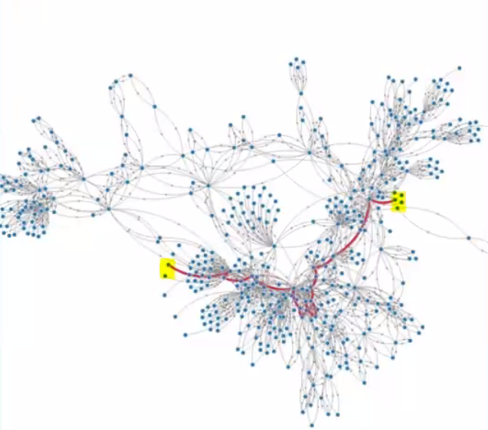
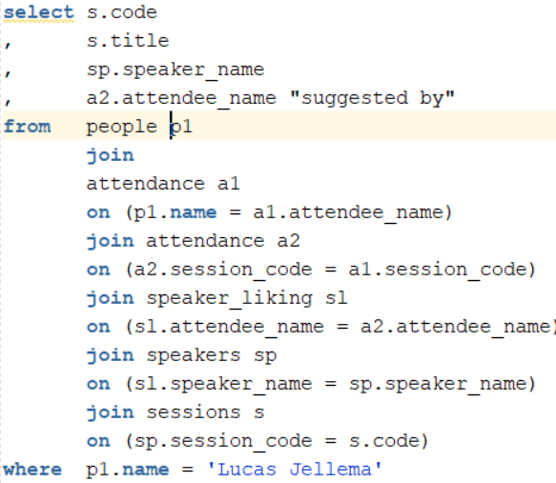
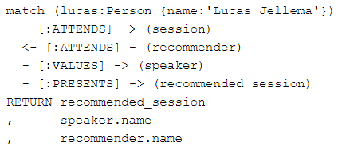
Cypher != SQL
SQL

Slide 60
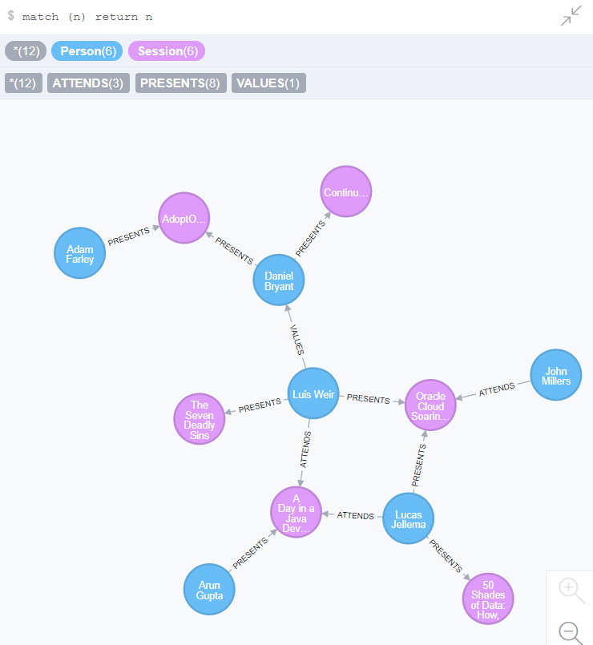
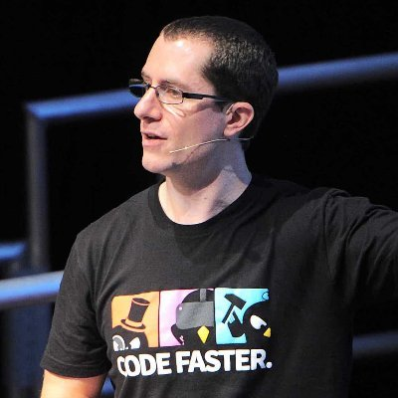

Session Recommendation Engine for Conferences
Recommend sessions to me
That are Presented by Speakers
Who are Values by People
Who Attended the same Sessions that I Attended
Start from me and the sessions I attended
Locate other attendees in these sessions
Find the speakers they like
Retrieve the sessions presented by those speakers
presents
presents
values
attend
attend

Slide 61
The Relational Approach
ATTENDANCE
PEOPLE
SESSIONS
SPEAKERS
SPEAKER_LIKING

Slide 62
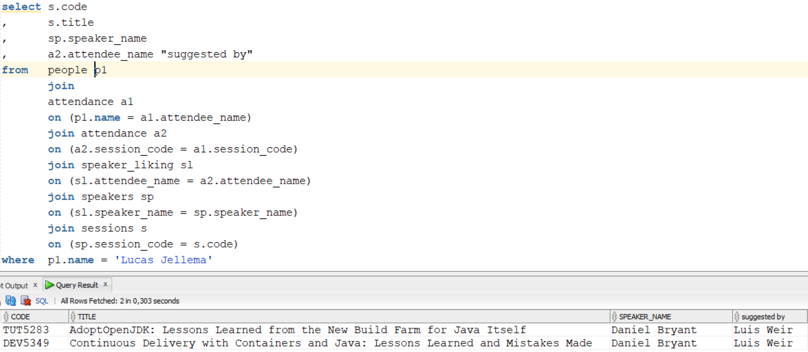
SQL Query to find the Recommendations

Slide 63
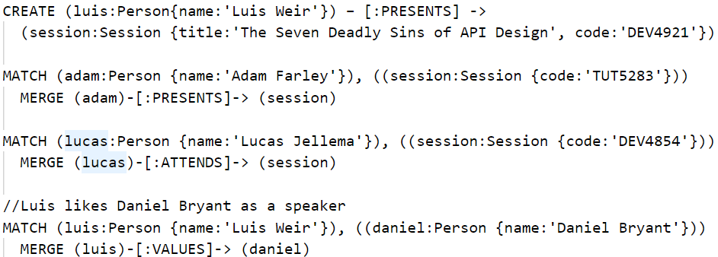
The Graph Approach (Neo4J using Cypher)
No tables are created
As data is created, meta-data is derived

Slide 64


The Graph Approach

Slide 65


Slide 66



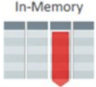




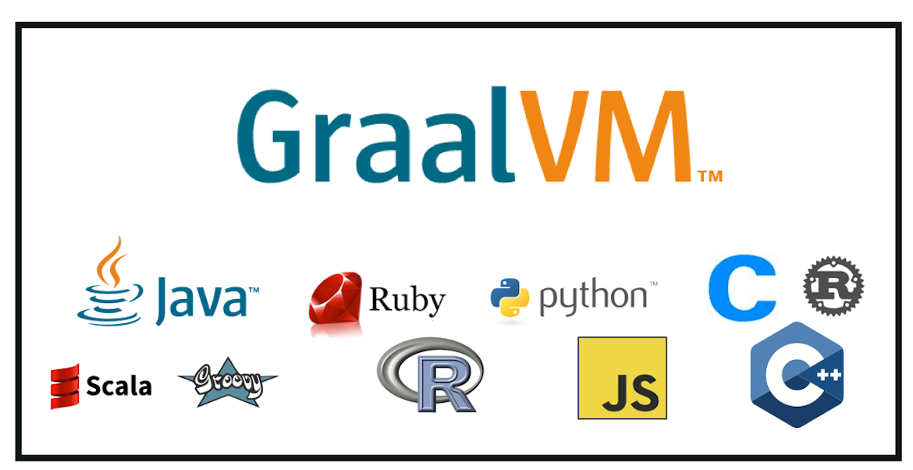

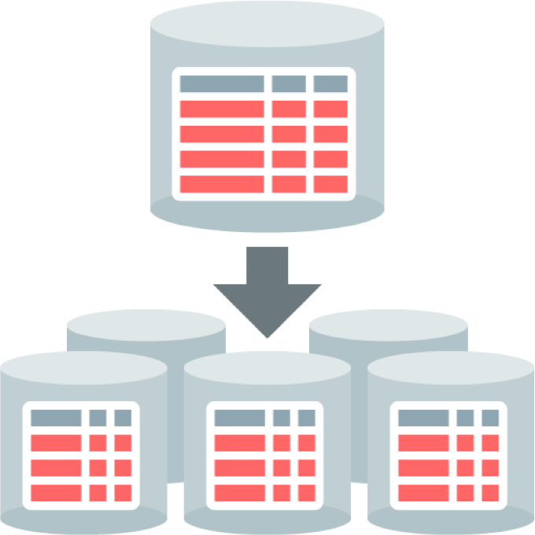



http
http
IoT Fast Data Ingestion
Flashback
Machine Learning
Cloud SQL
Sharding
No SQL
Multitenant (Pluggable Database) Architecture

Slide 67
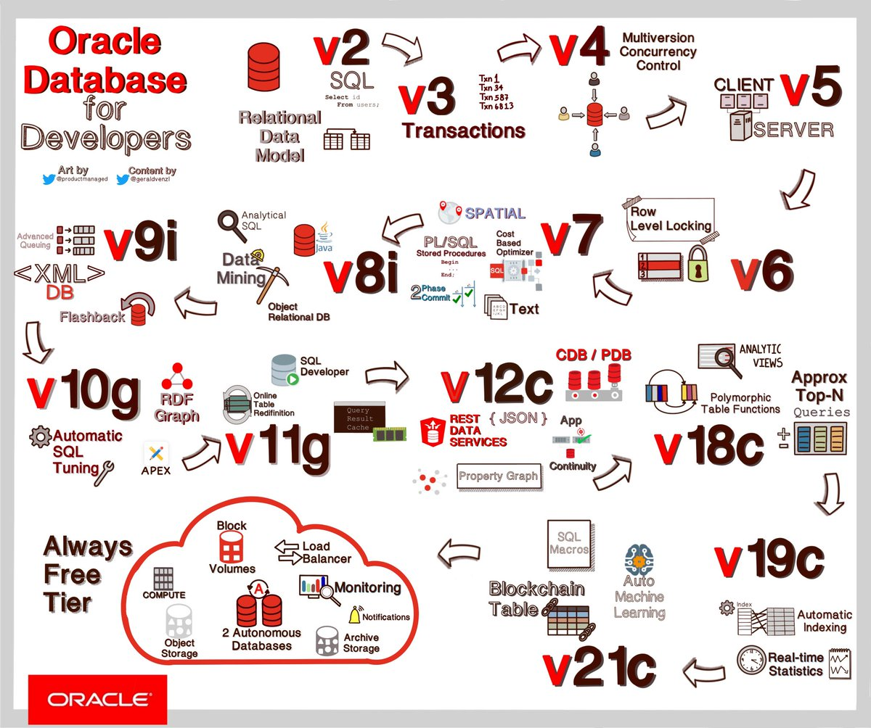

Slide 68
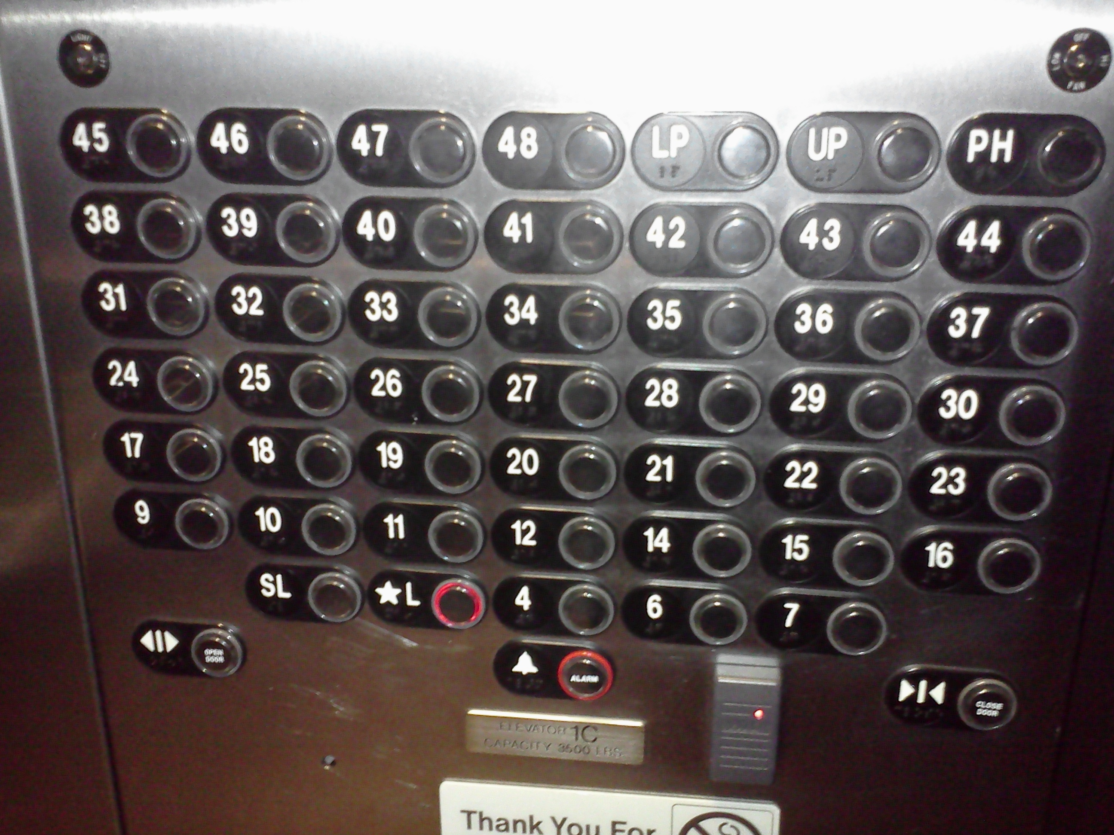



Slide 69
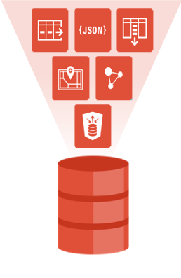

Converged Database

Slide 70
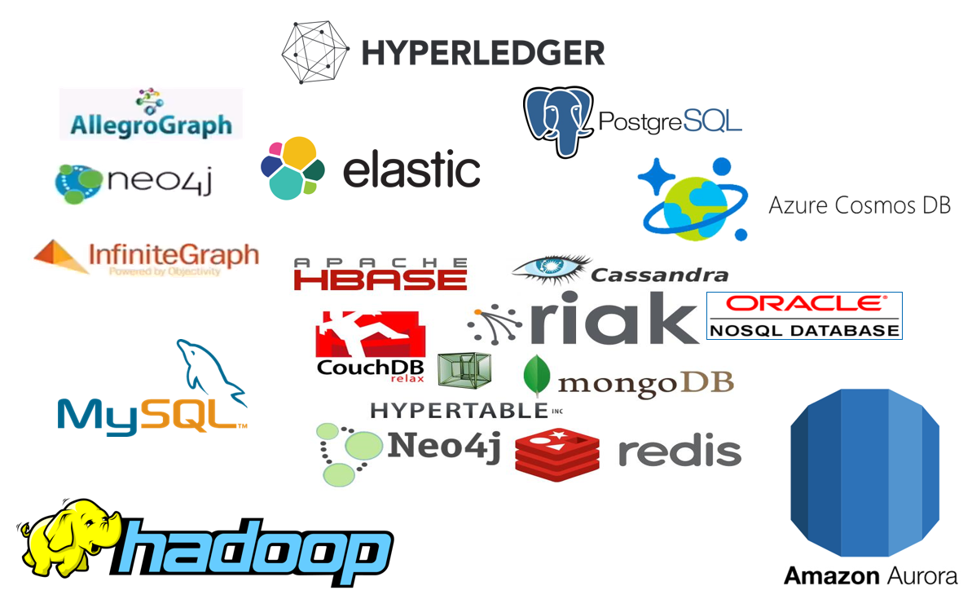




50 Shades of Data Wrap Up
On the many types of data, data stores and data usages
µ
µ
Notes:
Fast data arrives in real time and potentially high volume. Rapid processing, filtering and aggregation is required to ensure timely reaction and actual information in user interfaces. Doing so is a challenge, make this happen in a scalable and reliable fashion is even more interesting. This session introduces Apache Kafka as the scalable event bus that takes care of the events as they flow in and Kafka Streams and KSQL for the streaming analytics. Both Java and Node applications are demonstrated that interact with Kafka and leverage Server Sent Events and WebSocket channels to update the Web UI in real time. User activity performed by the audience in the Web UI is processed by the Kafka powered back end and results in live updates on all clients.
Fast data arrives in real time and potentially high volume. Rapid processing, filtering and aggregation is required to ensure timely reaction and actual information in user interfaces. Doing so is a challenge, make this happen in a scalable and reliable fashion is even more interesting. This session introduces Apache Kafka as the scalable event bus that takes care of the events as they flow in and Kafka Streams for the streaming analytics. Both Java and Node applications are demonstrated that interact with Kafka and leverage Server Sent Events and WebSocket channels to update the Web UI in real time. User activity performed by the audience in the Web UI is processed by the Kafka powered back end and results in live updates on all clients. Introducing the challenge: fast data, scalable and decoupled event handling, streaming analytics Introduction of Kafka demo of Producing to and consuming from Kafka in Java and Nodejs clients Intro Kafka Stream API for streaming analytics Demo streaming analytics from java client Intro of web ui: HTML 5, WebSocket channel and SSE listener Demo of Push from server to Web UI - in general End to end flow: - IFTTT picks up Tweets and pushed them to an API that hands them to Kafka Topic. - The Java application Consumes these events, performs Streaming Analytics (grouped by hashtag and author and time window) and counts them; the aggregation results are produced to Kafka - The NodeJS application consumes these aggregation results and pushes them to Web UI - The WebUI displays the selected Tweets along with the aggregation results - in the Web UI, users can LIKE and RATE the tweets; each like or rating is sent to the server and produced to Kafka; these events are processed too through Stream Analytics and result in updated Like counts and Average Rating results; these are then pushed to all clients; this means that the audience can Tweet, see the tweet appear in the web ui on their own device, rate & like and see the ratings and like count update in real time

Slide 71
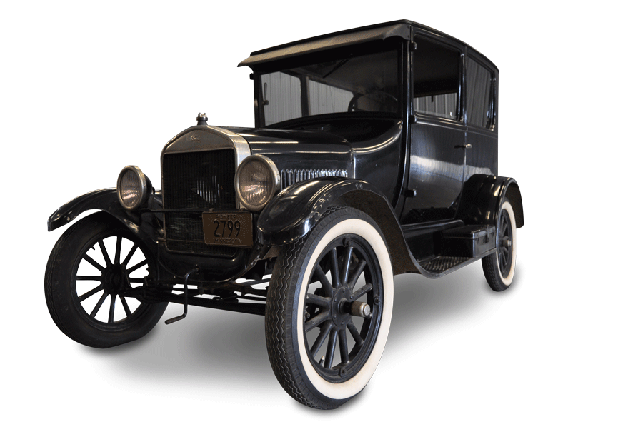

Slide 72

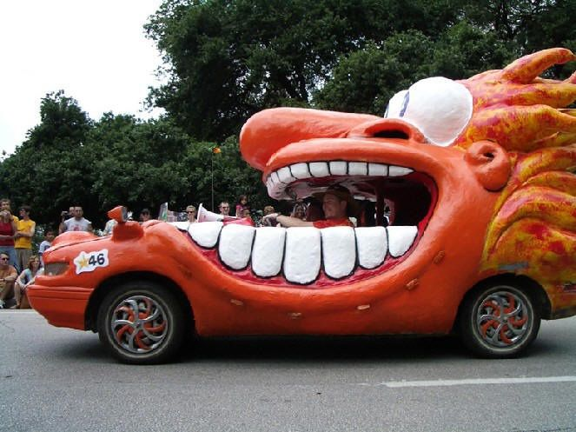










Notes:
Data used to be like T-Ford
One model, one color
And then:

Slide 73

location
Total Cost of Data Ownership
query patterns
usage
volume
volatility
format
distribution
required consistency
freshness requirements (staleness allowance)
integrity
speed
authorization
ACID demands
ownership
availability
Notes:
Data comes in many shades (at least 50) – variations along many dimensions

Slide 74




Losing my religion…
ACID is not always required or even desired
Integrity and Truth come in degrees – in many shades
Consistency – none | eventually | only states that have existed for real | always
SQL != relational, NoSQL != unstructured
Data is not itself intrinsically relational, document, streaming, graph-style, OO
data usage is
same data can have multiple usages
expose data in various ways, create derived data stores in various
Replicating data in shapes suitable for each use case is not bad a valuable tool
increase availability, performance, ease of consumption, reduction of compute – at the expense of a little lag in freshness and a replication mechanism
define the origin - Single Point of Truth
be prepared to discard and reconstruct derived data stores

Slide 75


Be aware
Unstructured Data has little value
Meta Data is crucial [to add structure]
Real Time does not exist, ASAP = $$$
Aim for Just Fresh Enough
SQL is lingua franca in data land
Storage is cheap
Role of events
Asynchronous communication
Current state is the sum of all change events

Slide 76
Thank you for your attention I hope this was useful
lucas.jellema@amis.nl | technology.amis.nl | @lucasjellema | lucas-jellema

